Slide 1
Juniper’s Launch in NYC
By Team 6QL: Anushree, Esteban, Sharon, Dylan, Teresa and our mentor Milda
Notes:
Feedback
- Exec summary - Some people have different stylistic preferences
-- Can be more helpful to have more detail e.g. revenue
-- Could be more in the middle in terms of too simple and busy
- Clear charts, not too much text
- Struggling to fit to follow the story. Link not completely made. Could reword it to based on fact that revenue not meeting expectations in other borough.
- Frame problem statement. One way could be that Brooklyn and Queens are not financially successful in terms of revenue in comparison to Manhattan.
- Implementation: To take it from good to excellent. More level of detail so if hand-off, team could execute but for COO, how long, cost, and how to know if it's successful, etc. at that level of detail for implementation
- Recommendations: Make it more clear timeline
- Could be pointing out Manhattan better as revenue is dropping so could make that story more clear

Slide 2
Executive Summary
How is the NYC launch going?
Key Insights from NYC launch
How can we meet our revenue goals?
Implementation and next steps
AGENDA

Slide 3
Executive Summary
Problem: Juniper shows significantly low revenue in Brooklyn & Queens and diminishing marginal revenue in Manhattan
Manhattan Total Revenue: $122,708
Revenue peaks in week 3 before declining by 27.7% in week 5
Brooklyn Total Revenue: $3,505
Queens Total Revenue: $35
The Solution:
Continue to grow business in Manhattan focusing on high-growth categories and addressing inefficiencies.
Focus on expanding in Brooklyn first before focusing on Queens
Attract merchants and focus on popular categories of restaurants to attract more couriers and customers
Opportunity:
Potential to increase revenue by offering customers more restaurant options, particularly among popular categories like “Italian”, “American”, “Japanese”, “Shop”.
Notes:
The solution: hone in on whats going well and add little more

Slide 4
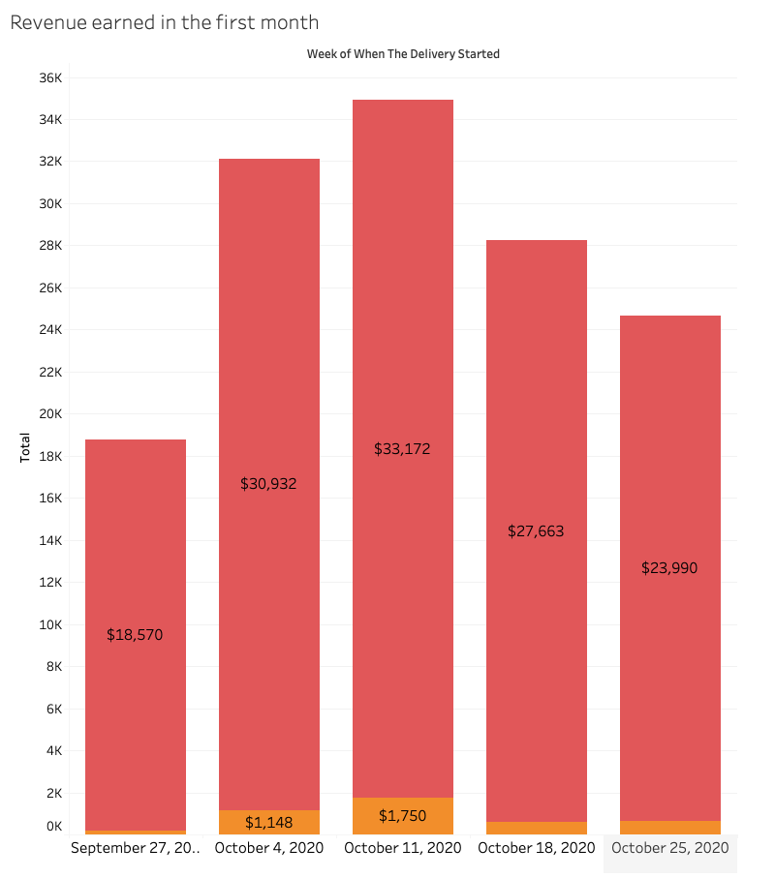

Overview of NYC Launch
It has been 4+ weeks since Juniper’s launch in NYC and we have seen that:
Manhattan shows signs of early success in terms of order volume however marginal revenue decreases
Customers favour certain cuisines more over others
There is potential of growth in Manhattan and for expansion in other boroughs
Notes:
Rev drops in manhattan - point it out

Slide 5
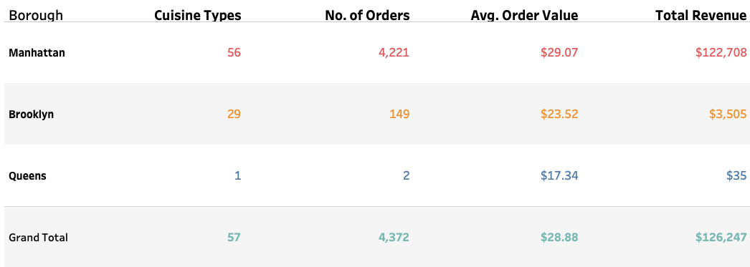
Manhattan orders make up 97% of NYC revenue in the first month
Manhattan shows prominent signs of success in all categories when compared to other boroughs in NYC especially with highest AOV
Notes:
All distinct values

Slide 6
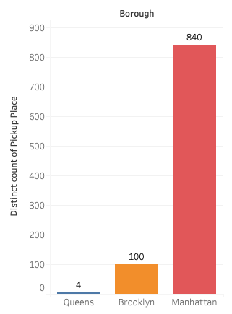
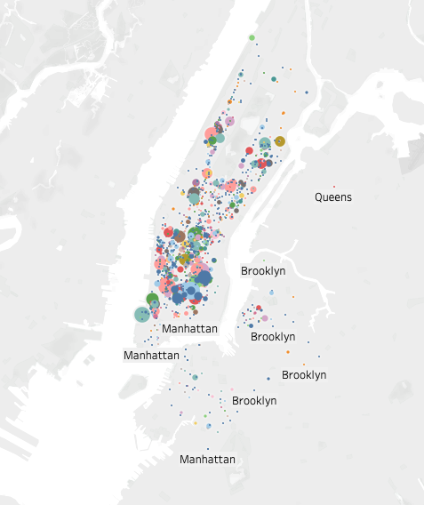
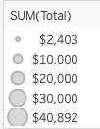
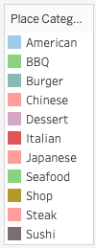
Manhattan leads restaurant density and variety
Total revenue
The amount and variety of restaurants in Manhattan leads more choices for customers and courier and therefore higher demand.
Notes:
Size of circle represents revenue volume

Slide 7
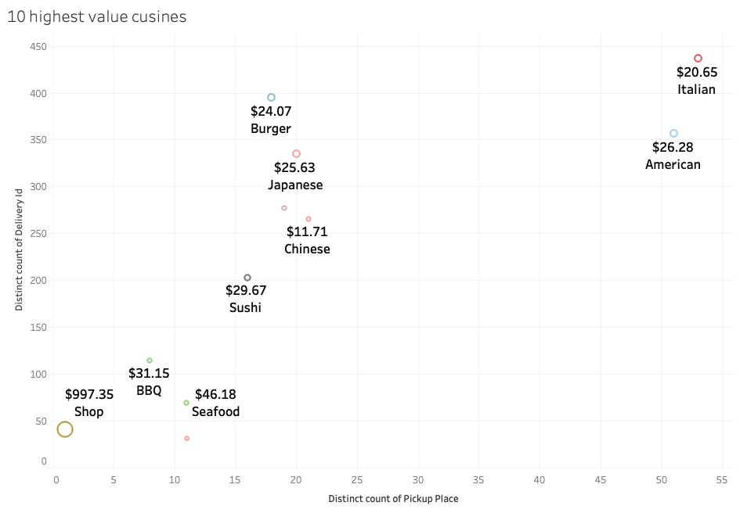
Maximizing Revenue in Manhattan: The Impact of High AOV and Delivery Volume in Select Cuisines
Burger and Japanese cuisine options have high-growth potential due to high customer demand and high AOV.
Italian and American cuisine categories yield high revenue and are promotable due to high quantity of orders.
The “Shop” category ranks as the top category from an AOV stand point though it has only 1 pickup place and presents an opportunity to explore further.
Notes:
Locations that can handle higher order rates - so replicate to keep it at AOV

Slide 8
Recommendations to Meet NYC Revenue Goals
1
2
3
Expand number of restaurants across leading cuisine categories in Manhattan to increase revenue:
If the top 4 cuisine categories grew by 50% (volume), monthly revenue would increase by ~$18k or a 15% total monthly revenue increase, keeping AOV constant.
Growing merchant base in Brooklyn, both in quantity and variety.
If we double the number of pickup places and increase AOV by only 25% (= Manhattan’s) there would be ~2.3x of monthly revenue in Brooklyn. (~$8.2K vs $3.5k today).
Begin developing future considerations for a soft launch in Queens based on areas of success in Brooklyn.
Notes:
Manhattan: top 4 total per month = $36k, 50% = 18K, and total for all = $122k so 18/122 = 15% increase
Brooklyn: 100 places bring $3.5k, if we double the pickup places and increase AOV to match manhattan, monthly revenue can increase by 3.5+1.2 = $4.7K (2.3x), so becomes $8.2K

Slide 9
Implementation
Priority 1: Growth in Manhattan
Acquire leading restaurants in high traffic area of Manhattan with large volume orders
Replicate onboarding programs from successful restaurants for new merchants to ensure smooth customer experience
Roll out targeted restaurant incentives for first-time customers to drive early growth of new restaurants
Measuring success on KPIs over an 8 week period with a focus on revenue, AOV, order rate in Manhattan.
Priority 2: Expansion in Brooklyn
Gathering data on customers, merchants, couriers in Brooklyn before scaling
Replicate the model behind Manhattan’s Juniper launch in Brooklyn to expand into greater variety in cuisines and increase users
Priority 3: Potential development in Queens
Conducting a pilot-project to test the viability of the service in Queen’s market to analyze operations, logistics, and user experience in a testing capacity
Notes:
- Implementation: To take it from good to excellent. More level of detail so if hand-off, team could execute but for COO, how long, cost, and how to know if it's successful, etc. at that level of detail for implementation
Queens: Conducting a pilot-project to test the viability of the service in Queen’s market to analyze operations, logistics, and user experience in a testing capacity
Gathering data on customers, merchants, couriers in Queen’s before scaling

Slide 10
Appendix

Slide 11
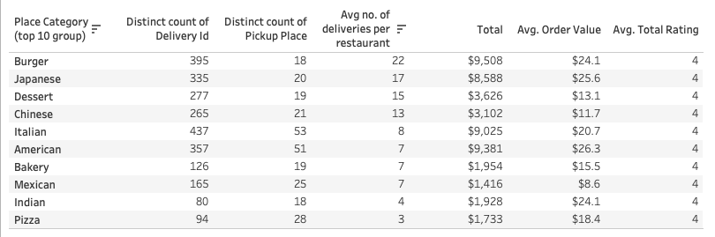
Appendix - Merchant data overview

